Slide 1
CPU Scheduling

Slide 2
Basic Concepts
Maximum CPU utilization obtained with multiprogramming
CPU–I/O Burst Cycle – Process execution consists of a cycle of CPU execution and I/O wait
CPU burst distribution

Slide 3
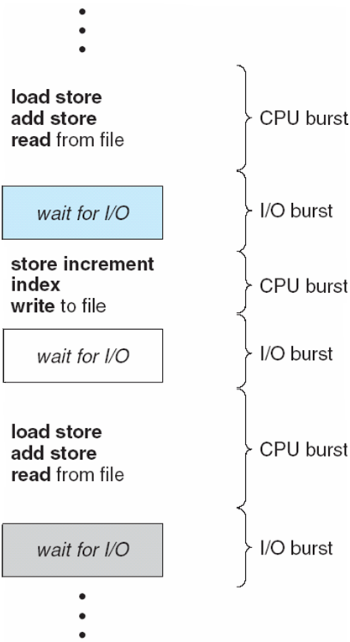
Alternating Sequence of CPU and I/O Bursts

Slide 4
CPU Scheduler
Selects from among the processes in memory that are ready to execute, and allocates the CPU to one of them
CPU scheduling decisions may take place when a process:
1. Switches from running to waiting state
2. Switches from running to ready state
3. Switches from waiting to ready
Terminates
Scheduling under 1 and 4 is non-preemptive
All other scheduling is preemptive – implications for data sharing between threads/processes

Slide 5
Dispatcher
Dispatcher module gives control of the CPU to the process selected by the scheduler; this involves:
switching context
switching to user mode
jumping to the proper location in the user program to restart that program
Dispatch latency – time it takes for the dispatcher to stop one process and start another running

Slide 6
Scheduling Criteria
CPU utilization – keep the CPU as busy as possible
Throughput – # of processes that complete their execution per time unit
Turnaround time – amount of time to execute a particular process
Waiting time – amount of time a process has been waiting in the ready queue
Response time – amount of time it takes from when a request was submitted until the first response is produced, not output (for time-sharing environment)

Slide 7
Scheduling Algorithm Optimization Criteria
Max CPU utilization
Max throughput
Min turnaround time
Min waiting time
Min response time

Slide 8
Turnaround Time
It is the time interval from the time of submission of a process to the time of the completion of the process.
Difference b/w Completion Time and Arrival Time is called Turnaround Time.
Completion Time (CT): This is the time when the process completes it’s execution. Arrival Time (AT): This is the time when the process has arrived in the ready state.
TAT = CT - AT

Slide 9
Waiting Time
The time spent by a process waiting in the ready queue for getting the CPU.
The time difference b/w Turnaround Time and Burst Time is called Waiting Time.
Burst Time (BT): This is the time required by the process for it’s execution.
WT = TAT - BT

Slide 10
First-Come, First-Served (FCFS) Scheduling
Process Burst Time
P₁ 24
P₂ 3
P₃ 3
Suppose that the processes arrive in the order: P₁ , P₂ , P₃ The Gantt Chart for the schedule is:
Waiting time for P₁ = 0; P₂ = 24; P₃ = 27
Average waiting time: (0 + 24 + 27)/3 = 17
Avg. TAT = (24 + 27 + 30) / 3 = 27
P₁
P₂
P₃
0
24
27
30

Slide 11
First-Come, First-Served (FCFS) Scheduling
Process Burst Time Arrival Time
P₁ 24 0
P₂ 3 2
P₃ 3 4
Suppose that the processes arrive in the order: P₁ , P₂ , P₃ The Gantt Chart for the schedule is:
Waiting time for P₁ = 0; P₂ = 24 -2 =22; P₃ = 27-4=23
Average waiting time: (0 + 22 + 23)/3 = 15
Avg. TAT = ((24-0) + (27-2) + (30-4)) / 3 = 25
P₁
P₂
P₃
0
24
27
30

Slide 12
FCFS Scheduling
Suppose that the processes arrive in the order:
P₂ , P₃ , P₁
The Gantt chart for the schedule is:
Waiting time for P₁ = 6; P₂ = 0; P₃ = 3
Average waiting time: (6 + 0 + 3)/3 = 3
Much better than previous case
P₂
P₃
P₁
0
3
6
30

